Slide 1
CHC Presentation
By Sven, Dragos & Nick

Slide 2
SWOT
Strengths: High quality service - Excellent facilities - Close to the beach - Relatively close to the city. - Good reputation amongst traveling agencies - Well established position with a firmly determined market niche
Weaknesses: Antiquated booking system, in regards to rooms as well as hotel facilities - Not very many family friendly facilities
Opportunities: Creating a prestigious reputation through high quality customer service would lessen the disadvantage of the higher price.
Threats: If the promise of high quality services and facilities goes undelivered, the reputation of the hotel will quickly drop and customers will seek other venues

Slide 3
Vision and Goals
More efficient booking system - provides better service to customers, reduces workload of employees, decreases chances of human error
Improving customer happiness - Through good customer service in the form of the high quality staff and IT systems. Having customers rate the IT system may help improve it.
Profit optimization - Streamlining the use of the hotel facilities through the IT system is meant to increase profits by reducing time wasted on sorting out who uses facilities when.

Slide 4
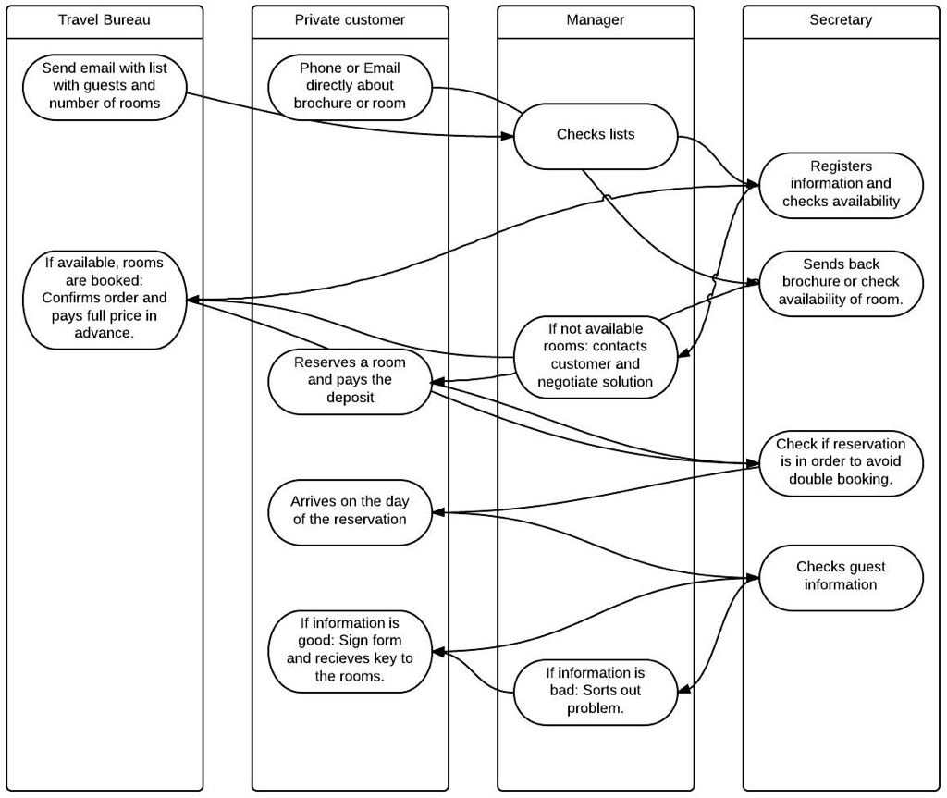
Activity Diagram AS-IS

Slide 5
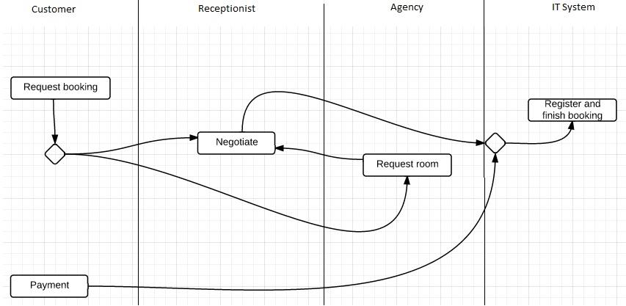
Activity Diagram To-Be

Slide 6
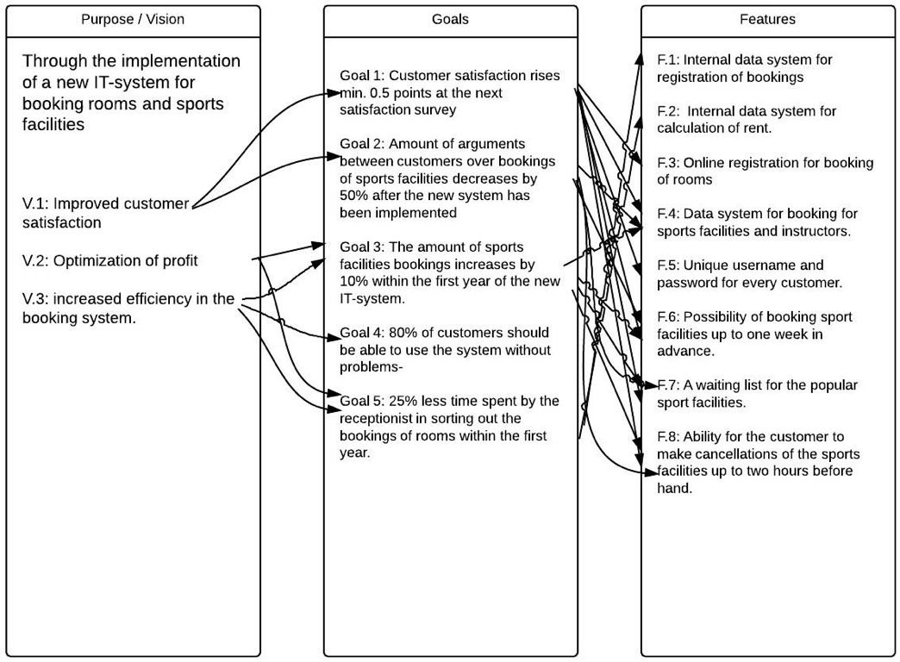
Feature List/Traceability model

